Slide 1
SSW-810: Software Engineering Tools and Techniques
Course Review
Prof. Jim Rowland
Software Engineering
School of Systems and Enterprises

Slide 2

Today’s topics
Review highlights from the semester
This is NOT all of the information covered on the final
Does identify most of the concepts I think are most important for you to know

Slide 3
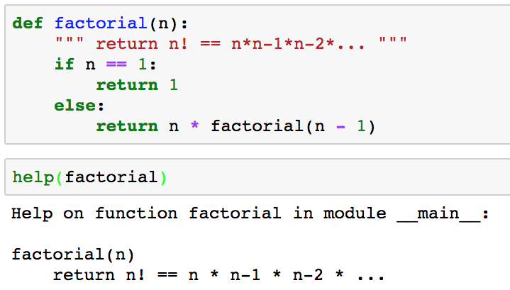
Documenting functions
Every file and function should begin with a docstring
docstring
A function’s docstring is available from the help() function

Slide 4
Fruitful functions
Every function returns a value:
return statement returns an explicit value
Falling out the bottom of the function returns None
Not all functions calculate a value to return to the caller
print(‘Hello world’)
Print returns None but we don’t use the return value or care
Functions that return a useful value are called fruitful functions
Some functions exist for their side effects, e.g. printing

Slide 5
Short circuiting
Python evaluates logical expressions from left to right
If the left operand of an or operator is True then the right operand is not evaluated and the expression is True
If the left operand of an or operator is False then both operands are evaluated and the result depends on the right operand
If the left operand of an and operator is False then the right operand is not evaluated
If the left operand of an and operator is True then both operands are evaluated and the result depends on the right operand

Slide 6
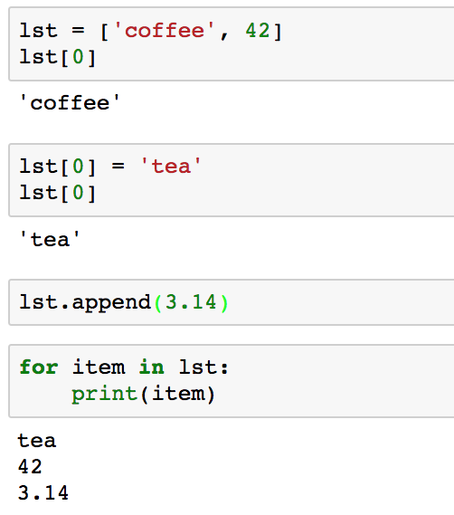
Python Lists
Lists hold arbitrary, ordered values of different types
Create a list
Access individual elements with slices offset from 0
Change the list with slices
Append items to the end of the list
Iterate through the elements in the list

Slide 7
Finding an item in a collection
I need to find my friend Nanda
I can knock on every door until I find him …
… or I can look up his address and go directly to the right door
Dictionaries map keys to values
Nanda Apt 5B

Slide 8
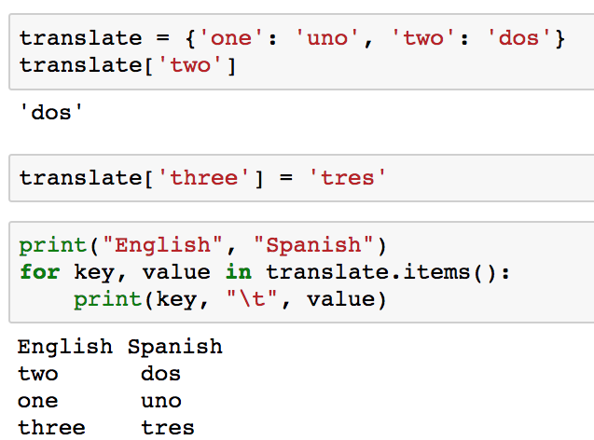
Python dict maps a key to a value
Key
Value
Initialize a dict
Use key to retrieve associated value
Add new key/value pairs
Iterate through key/value pairs
The order is undefined…

Slide 9
Objects provide encapsulation
Encapsulation bundles data and the operations that work on that data in a single place
Define a “box” that contains everything we need to know about rectangles and reuse that definition many times
Include both data and functions
Now it’s easier to create and manipulate many Rectangles
Easier to isolate Rectangles
Easier to test, enhance, maintain, and reuse Rectangles
Everything in one place
API
Rectangle:
length
width
area()
perimeter()

Slide 10
Why objects?
Objects help to design and organize code
Better encapsulation/compartmentalization
Break big problems into small, more manageable chunks
Reduce duplicate code
Increase reusability
Improve readability, maintainability

Slide 11
Classes represent objects
Objects have properties and behaviors
Define classes to represent objects
Classes have attributes and methods
Properties are represented as attributes with values
Methods are represented as functions that perform some behavior for the object
Object
Properties
Behaviors
Class
Attributes
Methods

Slide 12
Attributes can be added anytime
By convention, instance attributes are added in __init__()
Unlike C++ and Java, Python allows adding attributes to an instance of a class at any time
Including an attribute in __init__(self) adds the attribute to all instances
C++ and Java require all attributes to be included in the class definition
This might be a great feature or a unexpected (unpleasant) surprise

Slide 13
Attributes guidelines
Initialize all class instance attributes in __init__(self)
This insures they are defined and initialized
Helps readers to understand which attributes are available
Beware of typos that don’t generate warnings
Specify __slots__ to avoid surprises
class Foo:
def __init__(self):
self.cnt = 0
>>> f = Foo() # a new instance of class Foo
>>> f.ctn = 2
>>> f.cnt
0
>>> f.ctn
2
Oops!!I I meant to type ‘cnt’ but my typo added a new ‘ctn’ attribute available ONLY to the f instance of class Foo

Slide 14
Within a class definition…
self
Refers to the memory allocated for that instance of the class
First parameter in every method, including __init__(self)
Instance attributes
Data members that are included in every instance of the class
Defined in __init__(self)
Accessed as self.attribute
Methods
Functions defined for this class that may access any attribute using instance.method(args)
Each class instance has its own distinct copy of the instance attributes
Python passes instance as self

Slide 15
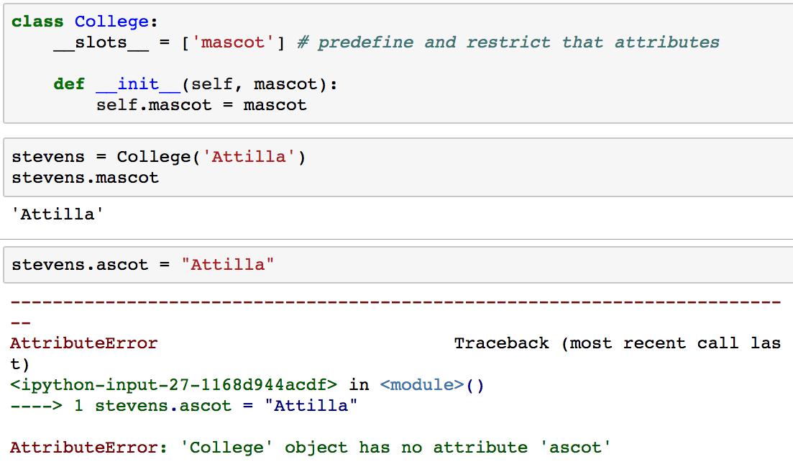
Avoid accidental attributes
Every class includes a __slots__ attribute that allows you to restrict accidental attributes
Only attributes included in __slots__ will be allowed
__slots__ is a class attribute that is shared across all instances of class College
Oops! ’mascot’, not ‘ascot’

Slide 16
Single Inheritance Summary
The subclass inherits all methods from the superclass
Super class instance attributes may be available, depending on if __init__() is redefined in the subclass or if super().__init__() is called
The subclass may add new class attributes, instance attributes, and methods
Any method, including __init__(), can be overridden by the subclass
If you override __init__() then you may want to call super().__init__() to create and initialize the superclass’s instance variables in the subclass
Or, define instance attributes needed by the subclass but that may defeat the advantages of using inheritance.

Slide 17
When to use OOP?
Python supports both Procedural and Object Oriented Programming
When to use each approach?
Objects have both properties and behaviors
If only behaviors then a function may be be simpler
If only properties, then a Python data structure may be better
If both, then a class is a good solution
How many instances of an object do you need?
Only one? A class may be overkill
Many? Class is a great solution
If inheritance is natural, then classes are a great solution
Use classes anytime they improve readability!

Slide 18
CRC Cards Example
Create CRC cards for the Rock/Paper/Scissors game
Identify a class (frequently nouns in the domain)
Add responsibilities (verbs associated with classes)
For each responsibility, identify collaborators
Create new classes for new collaborators
Iterate as you detect missing classes or collaborators
Class: Game Responsibilities | Collaborators
Get human move | Player
Get computer move | Player
Identify winner
Class: Player Responsibilities | Collaborators
Choose move

Slide 19
Microsoft Design Guidelines
Separation of Concerns
Single Responsibility Principle
Principle of Least Knowledge
Don’t Repeat Yourself (DRY)
Minimize Upfront Design (KISS)
Minimize overlap between components
A class/method/function should do one thing well
Minimize what others need to know about your internals (don’t know and don’t care)
Don’t duplicate functionality in multiple places
Keep it simple and elegant
https://msdn.microsoft.com/en-us/library/ee658124.aspx

Slide 20
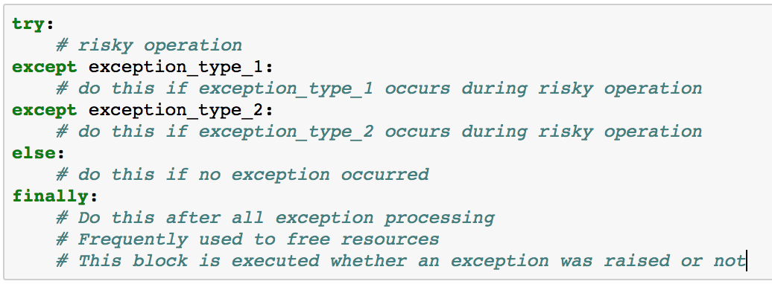
Exceptions: anticipate problems

Slide 21
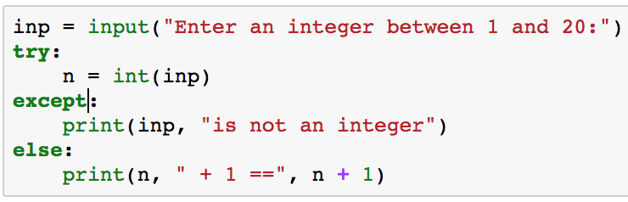
Unqualified except
Avoid unqualified except, e.g.
Unlike other languages with exceptions, Python uses exceptions for many situations
This block is invoked for ANY exception, not just the ones you expect

Slide 22
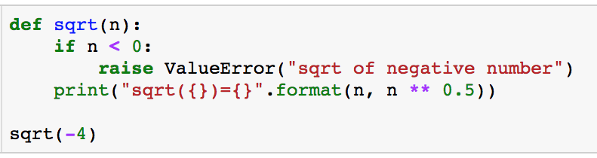
Program flow with exceptions
Raising an exception pops the runtime call stack, returning from functions, until the exception is caught:
in a try/except block somewhere in the call stack
by the Python interpreter (REPL)
Exception caught by the Python interpreter

Slide 23
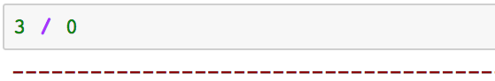
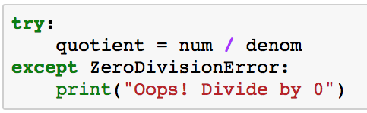
What was the name of that exception?
Recall, when it doubt, try it out…
What’s the name of the exception for divide by 0?
Here’s the name of the exception to use in the try/except block

Slide 24
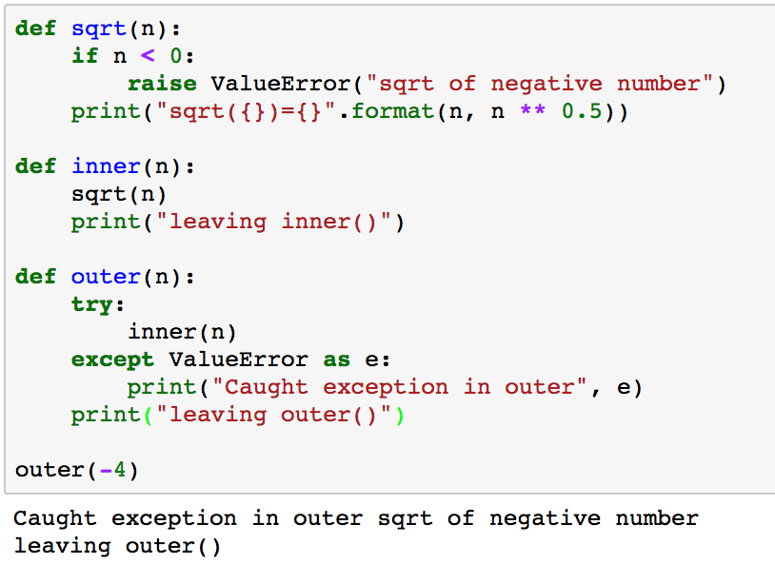
Program flow with exceptions
REPL calls outer(-4)
outer(-4) calls inner(-4)
inner(-4) calls sqrt(-4)
sqrt(-4) raises a ValueError Exception
Inner(-4) doesn’t catch the exception so execution flows to outer(-4) where exception is caught

Slide 25

LBYL vs EAFP Strategies
LBYL: Look Before You Leap (C++, Java)
Check carefully before attempting something risky to avoid exceptions
EAFP: Easier to Ask Forgiveness than Permission¹ (Python)
Write maintainable code that assumes everything is okay
Handle the situations where something goes wrong
Leads to more readable and maintainable code
¹Attributed to Admiral Grace Hopper, a computing pioneer

Slide 26
LBYL vs EAFP
LBYL: (Java, C++)
double
safe_div(float n, float d) {
if (d == 0) {
cerr << “divide by 0”;
return 0;
} else {
return n/d;
}
}
EAFP: (Python)
def safe_div(n, d):
try:
return n/d
except ZeroDivisionError:
print(“divide by 0”)

Slide 27
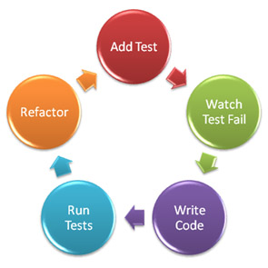
Test Driven Development
Write tests before you write the code
Test Driven Development (Kent Beck)
eXtreme Programming Agile Method
Writing the test helps you to think about the problem and write better code
https://assertselenium.files.wordpress.com/2012/11/tdd_cycle.jpeg

Slide 28

Software testing
The goal of software testing is to determine if the implementation meets its specifications
Does it do what it’s supposed to do?
Testing and debugging are related, but different tasks
Testing identifies problems – debugging fixes problems

Slide 29
Testing Strategies
Complete coverage, i.e. test all possible combinations?
Might be possible with a small range but typically not feasible
Choose a subset of values to test
Test each feature at least once
Test expected case
Test “around the edges”
What might we have missed?
Include both positive and negative tests
Positive: valid input produces valid output
Negative: invalid input is handled gracefully
Beware that tests can have bugs too!

Slide 30
Testing: Boundary conditions
Example: an integer x is valid from from a to b
a-1 a b b+1
Important test cases occur… | Test cases
At the boundary | a, b
A little before the boundary | a – 1
A little after the boundary | b + 1
Check < vs <= and > vs >= carefully!

Slide 31
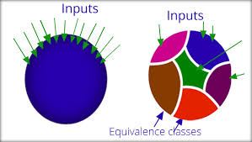
Testing: Equivalence classes
We can’t test all possible values
e.g. all float values between 0 and 1
Partition the range of values into equivalence classes, i.e. sets that we expect to behavior similarly
Use one value from the equivalence class to test all values from the equivalence class

Slide 32

How to implement and run the tests?
We’ve defined the tests we need for classifying triangles
How should we run the tests?
I’m a hacker! I don’t need tests!
Manually?
Not feasible in changing production environment
Automated testing is critical
Even for homework assignments!

Slide 33
Testing Strategies
Test each function
Test expected case
Test boundary conditions and “around the edges”
What might have been missed?
Include both positive and negative tests
Positive: valid input produces valid output
Negative: invalid input is handled gracefully
Beware that tests can have bugs too!
Missing important tests
Bugs in the test case

Slide 34

3 Steps to debugging
Step 1: Recognize that there is a problem (testing is one solution)
Step 2: Find the cause of the problem
Step 3: Fix the problem without breaking anything else
Automated testing helps to verify that the fix didn’t break anything
All three can be challenging! That’s why good software engineers are in such high demand (and earn such high salaries ;-)

Slide 35
Debugging techniques
Once you know there is a bug, how do you find it?
Approach | Advantages | Disadvantages
Read the code | Code reviews are the most effective way to find problems. | Difficult and time consuming, especially with unfamiliar, or large code. Most effective with highly experience readers.
Print statements | Simplicity – anyone can do it. | May be difficult to add enough print statements at the right place to be efficient. Must remove print statements.
Static code analyzers | No code changes needed. Helps to find “silly”, but subtle errors. | None
Debuggers | Fast, efficient, thorough | Small learning curve, but it’s a skill that will save countless hours.

Slide 36
Debugging Heuristics and Strategies
Divide and Conquer/Binary search
Minimize and isolate the code and data being debugged
New code is more likely to have bugs than older code
Try to get back to a working state
Boundary cases are always suspect
Beware of integration points with other modules and code authors
Check the easy things first, e.g. silly mistakes
Learn from your mistakes so you don’t make them again

Slide 37
Divide and Conquer/Binary Search
Goal is to isolate the problem to minimize the places the bug can be hiding
Remember, the bug may be in the code or the data
Cut the search space in half and try to isolate the problem to one half or the other
10
5
15
2
7
12
17
1
3
6
8
11
13
16
18
4
9
14
19

Slide 38
Cut the search in half, test, repeat…
Isolate the problem to half of the problem space
Reduce the code
Reduce the data
Reduce the space we need to search

Slide 39
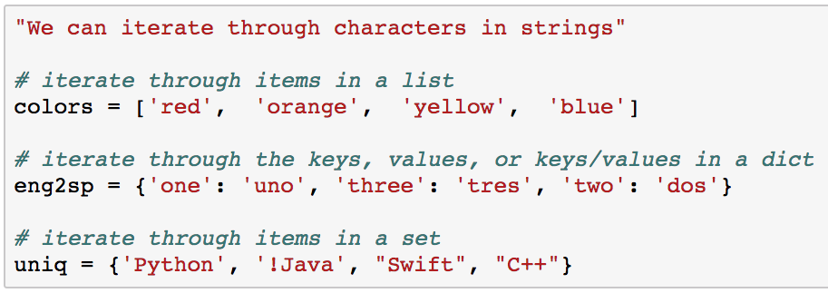
Sequences and iterators
Python supports several types of sequences
Both ordered and unordered collections of items
Sequences support iterators to iterate over the items
Examples of Sequences:

Slide 40
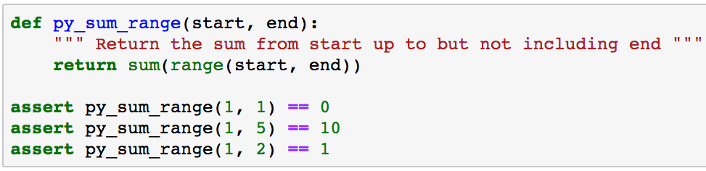
Write a Pythonic* function
Write a Pythonic function to calculate the sum of a range of integers from start, up to, but not including end
* Writing Pythonic code means to think about how Python works and take advantage of built in functionality, even if it’s different from other programming languages

Slide 41
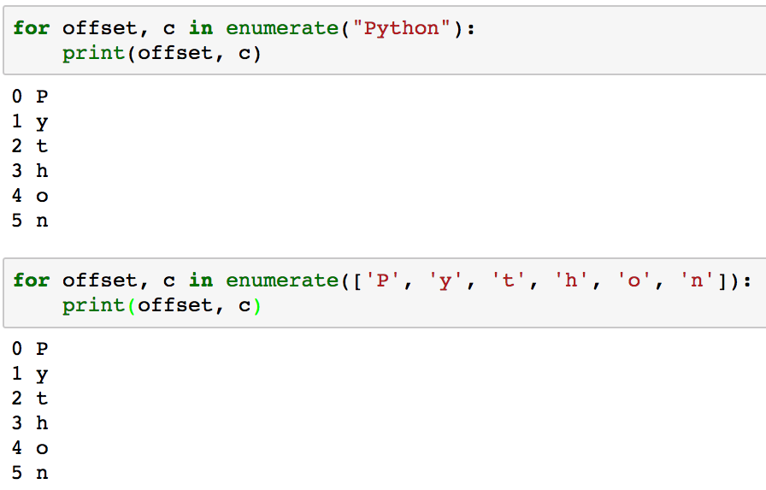
enumerate() and sequences
enumerate is a convenient way to assign an offset to an item in a sequence

Slide 42
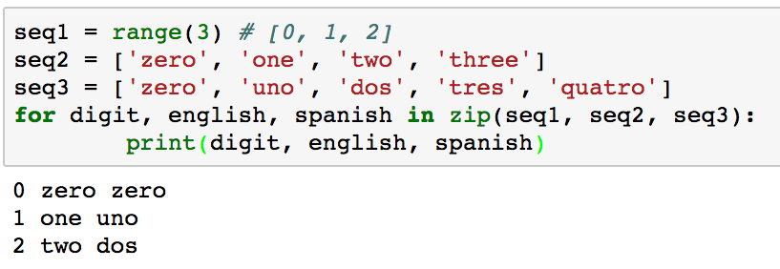
zip(*sequences)
zip helps you to iterate through multiple sequences
zip(*sequences) stops after the shortest sequence is exhausted
foo(*args) takes any number of arguments

Slide 43
Operations on sequences
Python provides built-in operations for all sequences
How would you implement these operations with loops?
Operation | Description | Example
len(s) | Return the number of items in the sequence | len(‘hello’) == 5 len([‘a’, 1, 3.4]) == 3
min(s) | Return the min value | min(‘hello’) == ‘e’ min([1, 3.2, 7]) == 1
max(s) | Return the max value | max(‘hello’) == ‘o’ max([1, 3.2, 7]) == 7
value in s | Return True if value is in s else return False | ‘e’ in ‘hello’ == True 3.2 in [1, 3.2, 7] == True
value not in s | Return True if s is not a member of s else return False | ‘x’ not in ‘hello’ == True 2 not in [1, 3.2, 7] == True

Slide 44
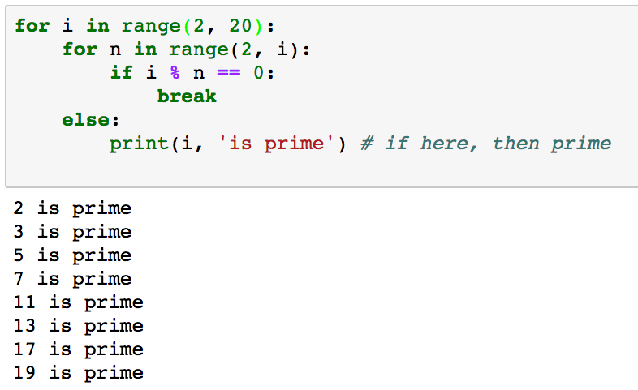
Using for/else
The else clause is executed if the loop terminates naturally, without break

Slide 45
Generators
Generators create custom sequences with lazy evaluation
The generator creates the next item in the sequence on demand
Don’t create the next item until requested
Consider a system that collects data from an internet feed, e.g. the Twitter feed for Python tweets
for tweet in twitter_feed():
tweet.analyze()
We could read N tweets in advance and store them in a list or we can use a generator to get the next tweet
Generators are great for co-routines
cat file | filter1 | filter2 | filter3

Slide 46
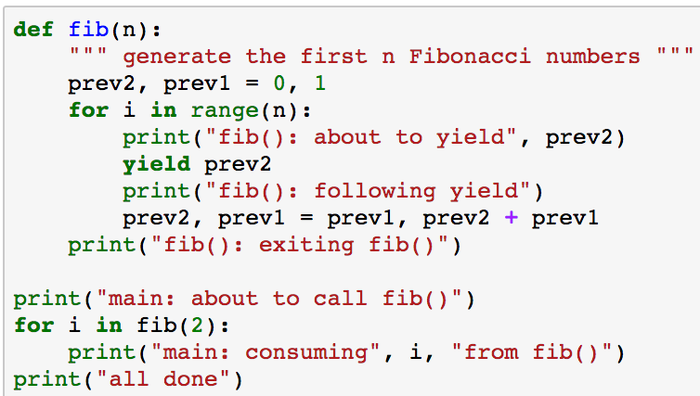
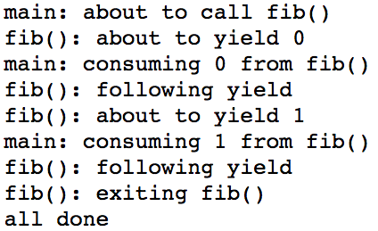
Running generator functions

Slide 47
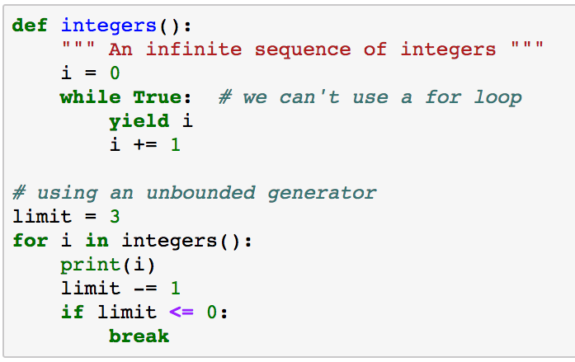
Unbounded generators
Return the next integer for as long an anyone calls __next()
Need to limit the number of calls

Slide 48
When to use generators?
Any time you need a sequence
Generators are more efficient than prepopulating a list
While waiting for asynchronous events
Any time lazy evaluation makes sense
e.g. very large sequences
Any time you may need to read multiple lines from a file to retrieve a single entry

Slide 49
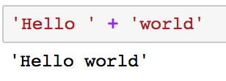
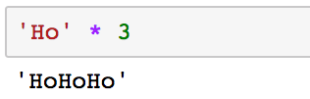
Python string manipulation
Concatenation
Replication

Slide 50
Slices of sequences
[ start : end : step ]
start - the offset from the beginning (offset from 0)
end – up to, but not including end, i.e. end – 1
step – skip every step items
start, end, and step arguments are optional

Slide 51
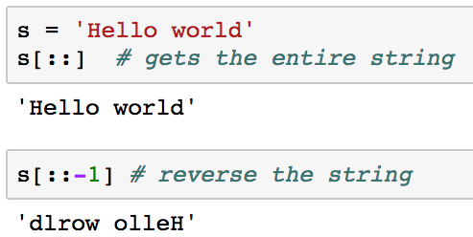
Reverse a string with slices
Problem: How to reverse a string using only slices
Recall slice[start : end : step]
We want the entire string, but we want to step from the end back to the beginning
Be careful about trading cleverness for readability!

Slide 52
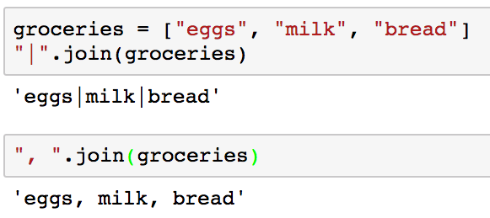
String.join(sequence)
String.split(delim) splits a string into tokens
String.join(sequence) creates a string from a list of tokens separated by String
These string methods are used frequently!

Slide 53
String Methods
String class supports a number of useful methods
String Method | Semantics
string.startswith(s) | returns True if string begins with s
string.endswith(s) | returns True if string ends with s
String.split(sep=whitespace) | Split a string into tokens
string.strip() | strips leading and trailing whitespace
string.lstrip() | strips leading whitespace
string.rstrip() | strips trailing whitespace
See https://docs.python.org/3/library/stdtypes.html

Slide 54
Python Coding Style Guidelines
Coding style guidelines provide consistency
Coding style guidelines make code easier to read and understand:
Encourage consistency across a project or organization
Help the reader to recognize relevant chunks of code
Consistent use of white space
Consistent formatting of program elements
Avoid developing and using bad habits
If your project has a coding style then follow it
Otherwise adopt an existing coding style
Google: http://google.github.io/styleguide/pyguide.html
Python: https://www.python.org/dev/peps/pep-0008/

Slide 55
Working with files
Steps for reading from a file:
Get file name
Open the file
Read the file
Line by line
All at once into a list of lines
All at once into a buffer
Close the file

Slide 56
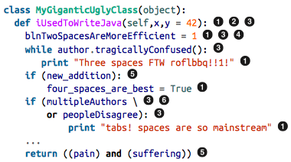
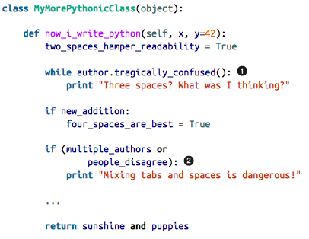
Python Style: Bad vs Good
Indentation issues
White space issues
Inconsistent case
Hungarian Notation
Extraneous parens
Extraneous line continuations
Source: How to Make Mistakes in Python
by Mike Pirnat
Copyright © 2015 O’Reilly Media, Inc. All rights reserved.

Slide 57
Sample Guidelines
Indentation: use 4 spaces per indentation level. Don’t use tabs.
Blank lines:
Use blank lines sparingly in functions to indicate logical sections
Use two blank lines between top level function and class definitions
Use one blank line inside a class to separate method definitions
String quotes: use either single or double quotes consistently
Avoid multiple statements per line
Docstrings should be used for all public modules, functions, classes, and methods
Avoid global variables
Global constants are okay
Use parens sparingly
Explicitly close every file you open

Slide 58
Coding Guidelines
Coding guidelines improve code readability and maintainability
Don’t require a lot of effort
Coding guidelines are all about being consistent
Within your code
Within your organization
May seem to be much ado about nothing
Low cost, high reward

Slide 59
Containers
Python provides several different types of containers
Lists - arbitrary values and mutable - [1, 2 3]
Tuples - like a list, but immutable - (1, 2, 3)
Dictionaries – Key/Value pairs – {’one’:1, ‘two’:2, ‘three’:3}
Sets – {1, 2 3}
Like lists, but with only unique values
Like lists, but unordered
Like dictionaries, but no keys, only values
These containers are fundamental in Python and are used in most Python programs

Slide 60
List methods
Method | Action
list.append(element) | Append an element to a list
list.extend(sequence) | Concatenate list and sequence
list.insert(index, object) | Insert object at position index or at the end if index > len(list)
list.remove(value) | Remove the first instance of list with specified valur or raise ValueError
list.count(value) | Count the number of instances of value in the list
list.index(value) | Return the index of value in list or raise ValueError if not found
list.pop(index) | Remove and return the value at index.
list.pop() | Remove and return the last value in the list
List.sort() | Destructively sort the elements in the list
sorted(list) | Sort a copy of the list
element in list | True if element is a member of list, else False

Slide 61
List methods
Method | Action
e in L | True if any element in L == e
e not in L | True if no element in L == e
L1 + L2 | Concatenate L1 and L2
L1 * n | Concatenate L1 to itself n times
L1[i:j:k] | Slices
len(L1), min(L1), max(L1 | Length of L1, min value, max value
min(L1) | Smallest item in L1
max(L1) | Largest item in L1

Slide 62
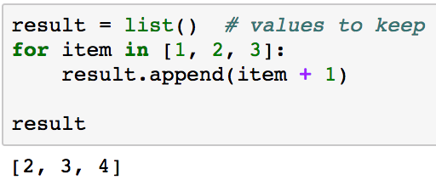
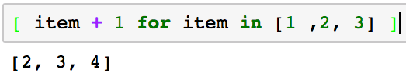
List comprehensions
Transforming lists is very common in Python programs
List comprehensions are a syntactic shortcut
Same logic with list comprehensions (1 line vs. 3 lines)

Slide 63
lambda: anonymous functions
lambda expressions are one line, anonymous functions
lambda parameters: expression
Is equivalent to
def <anon>(parameters): return expression
expression must be a pure expression
No assignment, if, while, for, try, return, … statements
Lambda expressions are fairly uncommon in Python 3.*
lambda was popular before list comprehensions
Used frequently with map(), filter(), and reduce()
Popular when using Python as a Functional language

Slide 64
collections.namedtuple syntax
MyType = namedtuple(‘MyType’, [list of fields])
namedtuple allows you to access values by name rather than position

Slide 65
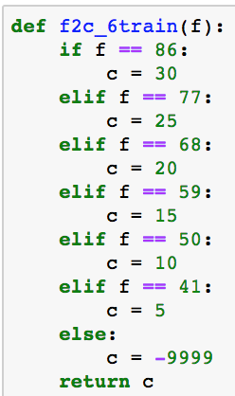
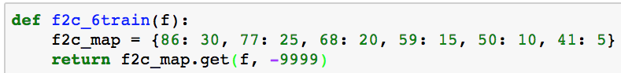
Replace long if/elif/else blocks with dict
Replace this long, error prone if statement with a dict

Slide 66
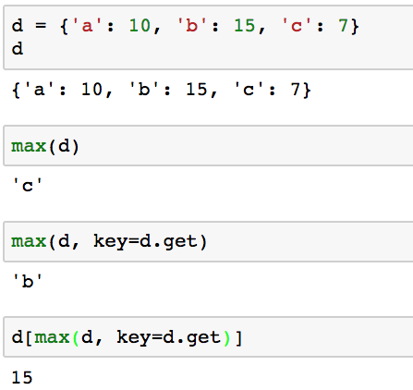
Finding dict’s max key or key associated with the max value
How can we find the max/min key in a dictionary?
Return the max key value
Return the key with the max value:
max(dict, key=dict.get) returns the key associated with the max value in dict

Slide 67
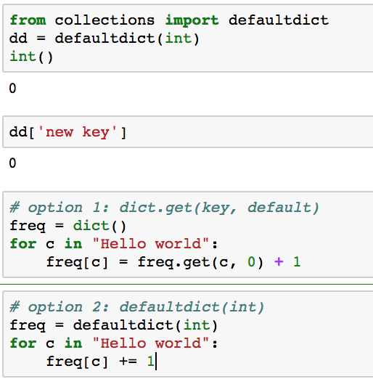
Special case dictionaries: defaultdict
collections.defaultdict(factory) assigns a default value from the specified factory if the key is not found
Int() returns 0 which gives a default of 0
The default value of any new key is 0
These two options do the same thing.
Which is easier to read?
If c is already a key, then return freq[c]
else freq[c] = 0, then increment the value

Slide 68
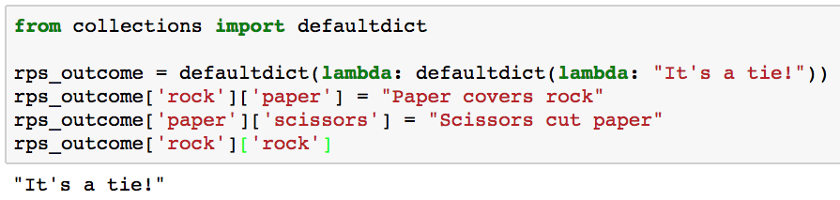
Defaultdict with multiple keys
What if we want a defaultdict with multiple keys?
rps_outcome[human] is a defaultdict(lambda: ”It’s a tie!”)
This provides a default outcome for unspecified combinations of human and computer moves

Slide 69
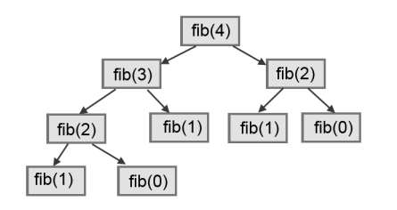
Memoization/caching
Memoization speeds up calculations by creating and maintaining a cache of previous results
Don’t recalculate each time, just retrieve it from the cache
Dictionaries are a great way to implement caches
Examples: recursive factorial, recursive Fibonacci
✔
Call | Count
fib(4) | 1
fib(3) | 1
fib(2) | 2
fib(1) | 3
fib(0) | 2
✔
✔
✔
✔
✔
✔
Why didn’t this call fib(0)?

Slide 70
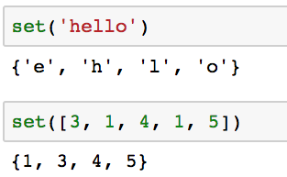
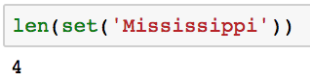
Finding unique items
Sets provide a convenient way to identify the distinct values from an iterator, e.g. string, list, tuple
How many distinct characters in “Mississippi”?

Slide 71
When to use which container?
Lists
Ordered items of any type
Duplicates are fine
Add to or delete from beginning or end
Great for stacks (LIFO) and queues (FIFO)
Tuples
Immutable version of lists
Returning multiple values from a function
Tuple unpacking for multiple assignments or swapping values

Slide 72
When to use which container?
Dictionary
Key/Value pairs
Good when associating information with a key
Great for look up tables
Great for counting distinct elements
Sets
Great any time you need set operations
Easy to identify distinct elements from an iterator, e.g. string, list, tuple

Slide 73
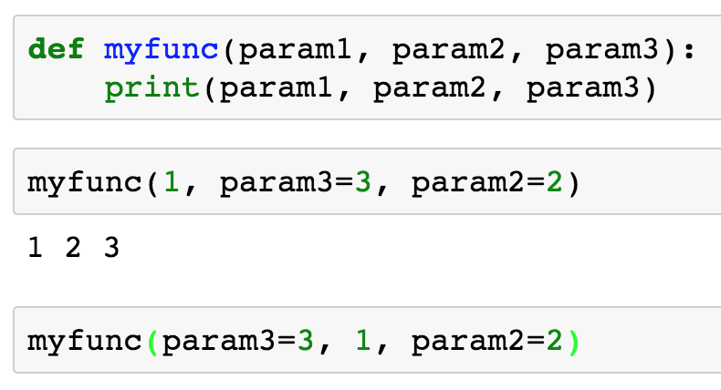
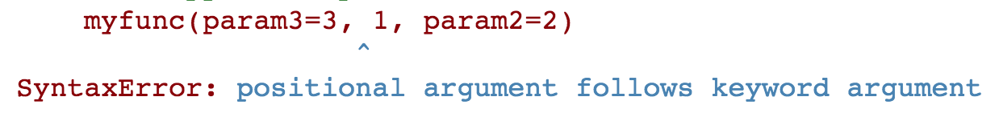
Mix positional and named arguments
All positional arguments must be specified before any named arguments
Mix positional and named arguments
All positional arguments must precede name arguments, i.e. named parameters must be specified last

Slide 74
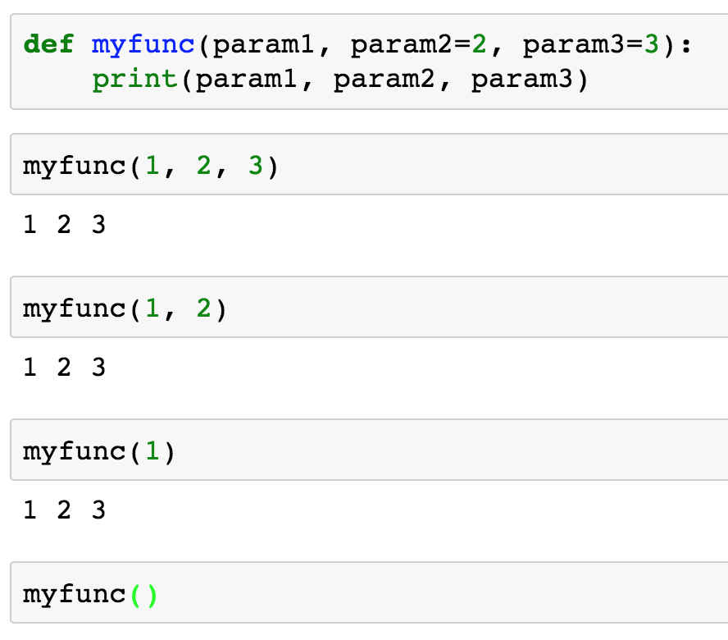
Optional parameters with default values
Functions/methods may define optional parameters that assume default values if corresponding arguments are not passed by the function call
param1 is required
param2 defaults to 2 if not specified
param3 defaults to 3 if not specified
Param1 is required

Slide 75
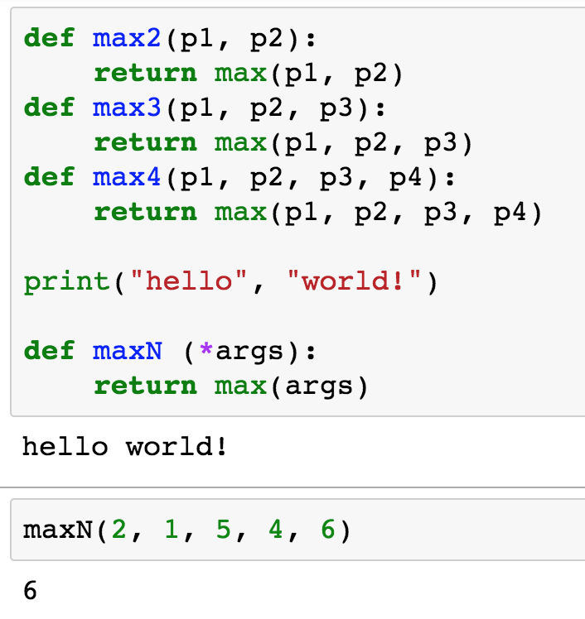
Variable number of parameters
We sometimes want to accept a variable number of parameters
How many versions do we need?
Print accepts a variable number of arguments. Can we do that?
Accept an arbitrary number of arguments and assign them to a tuple with name ‘args’

Slide 76
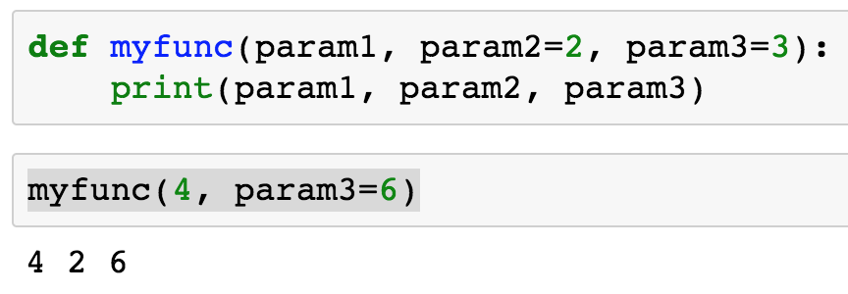
Mixing optional and named parameters
Function calls may mix positional, named, and optional arguments
param1 == 4
param2 defaults to 2
param3 passed by name

Slide 77
3 Ways to import Python modules
import module_name [as alias]
from module_name import object_{1..n}
from module_name import *
This option blindly loads everything from the module into your namespace which may cause conflicts
Don’t do this!!!

Slide 78
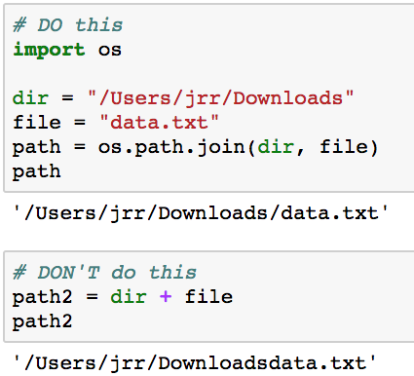
os.path.join(dir, file)
os.path.join(dir, file) does the right thing across operating systems and if path ends with or without trailing ‘/’

Slide 79
Decorators
Decorators allow us to extend the behavior of a function without modifying the function
Wrapping extra functionality before and after a function
Examples:
Time a function call
Track how many times a function is called
Memoize a function to use previous results
Mock a function call while testing
Web frameworks, e.g. Flask
https://wiki.python.org/moin/PythonDecoratorLibrary

Slide 80
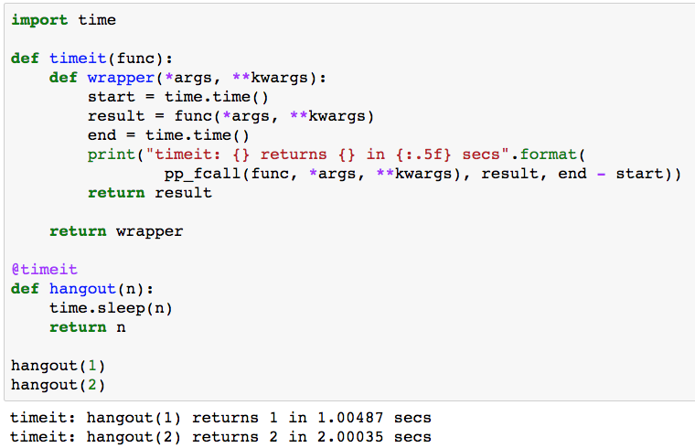
Execution time decorator
Accept any number/type of arguments
Print function elapsed time

Slide 81


Information Hiding: Public vs Private interfaces
 | Public Interfaces | Private Interfaces
Sharing | Shared freely with other modules | Not shared: details are hidden
Used by others | Safely used by other modules without concern of changes | Not available to other classes
Cost of change | New interfaces are cheap but changes may be very expensive if the change breaks other modules | Class implementation may change without impacting other modules

Slide 82
What are we protecting from whom and why?
What?
Attributes and methods critical to the proper behavior of the class
Design decisions, e.g. critical data structures
From whom?
Programmers (including the class author) with access to code
Data privacy is not relevant because the code is available
Subclasses derived from the superclass
Why?
Improve encapsulation to allow the internal implementation to change without impacting the public interfaces used by other code

Slide 83
@property, @setter
Python discourages getter/setter functions for attributes
Instead, Python encourages obj.attribute notation both for getting and setting attributes
What if you need extra logic around a getter or setter?
e.g. check for a valid range before returning or setting value
@property/@setter allows you to define a property of a class which is a function wrapper for an attribute’s getter and setter with extra functionality
Execute extra code while allowing users to use obj.attribute notation for getting/setting values

Slide 84
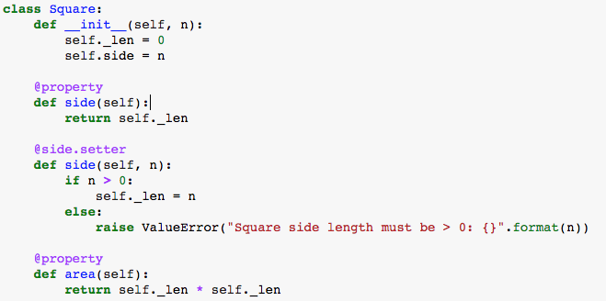
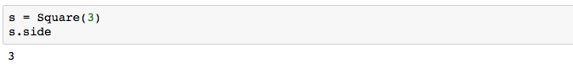
@property/@attribute.setter example
_len holds the protected length of the side
Users refer to ‘side’
Call the setter to check the value
Prevent setting _len < 0, even in __init__()

Slide 85
@property/@attribute.setter Summary
@property decorator adds a read-only attribute to a class that calls the associated method when the attribute is accessed with dot notation
@attribute.setter decorator adds a setter method to attribute where the method is invoked when the attribute is accessed with dot notation
@property and @attribute.setter can be used together or @property can be used alone for read-only
Can be added after code deployment to change behavior of an attribute without changing legacy code, e.g. add checks

Slide 86
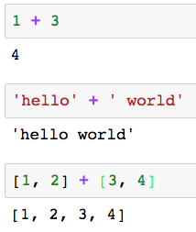
Polymorphism
Polymorphism allows an operator to behave differently depending upon the types of the operands
How does this work?
How does Python know which version of ’+’ to apply?
integer arithmetic
string concatenation
list concatenation

Slide 87
Dynamic and Static Typing
Statically typed
C++, Java
Variables are declared with a static type
The compiler uses the static type information to support polymorphism
Dynamically typed
Python
An object’s type is determined at run time
Python chooses the appropriate class method based on the type of the object

Slide 88
Duck Typing
Duck typing is a dynamic typing method
Python uses duck typing to support polymorphism
If it walks like a duck and quacks like a duck, it’s probably a duck
Python: if an object has a relevant property, then apply it
Duck typing supports polymorphism with or without inheritance

Slide 89
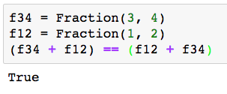
Duck typing example
Recall the Fraction homework from earlier in the semester
We used Python’s magic methods to support inline operators
Python determines the type of f34 and f12 at run time to choose the appropriate version of __add__() to invoke
We can use Duck Typing with or without inheritance to simplify out design and implementation

Slide 90
Private/Protected attributes/methods
Java and C++ enforce public, protected, and private in the compiler
Python assumes that we’re all responsible adults and everyone will follow the Python conventions:
name (no _) tells the reader that name is public
_name (single _) tells the reader that _name is protected
__name (double _ ) tells the reader that __name is private and shouldn’t be used

Slide 91
Instance Attributes vs Class Attributes
Instance attributes are replicated in every instance of a class
Defined in __init__() or added after the class is defined
class Employee:
def __init__(self, role):
self.emp_role = role
A distinct instance of emp_role is included in every instance of class Employee

Slide 92
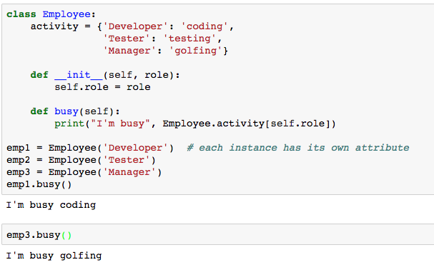
Instance Attributes vs Class Attributes
A Class attribute exists exactly once across all instances of a class
Defined outside __init__() or after the class is defined
A single instance of Employee. activity is shared across every instance of class Employee

Slide 93
Static Methods
Static methods look just like other methods but are not associated with a specified class instance
No self parameter because the method is not associated with a a specific instance
Instance attributes are not available – no class instance
Class attributes are available
Static methods can be replaced with procedural function calls
Static methods offer extra encapsulation and consistency
Static methods are fairly unusual

Slide 94

Software evolution
We don’t always get software right the first time
Code changes with changes in requirements, architecture and design
Some Agile Methods (XP) emphasize providing the simplest solution that meets all requirements, but may require later changes
How to optimize code readability and maintainability without losing functionality and reliability?

Slide 95
What is refactoring?
Refactoring: changing the internal structure of software to make it easier to understand and cheaper to modify without changing its observable behavior
http://www.moniro.com/my_pictures/product-software-refactoring.png

Slide 96
Why refactor?
We start with a good design and write good code to implement that design
BUT, over time the code changes to meet changes in the requirements
BUT, the design may not be updated to optimize those changes
Refactoring refreshes the design and the code to reflect an optimal solution for our latest understanding of the problem and solution

Slide 97
Technical debt
Additional development, testing, and maintenance effort
Caused by
Bad design
Taking shortcuts, and
Not implementing the “right” solution throughout the lifecycle
Quick hacks add technical debt
Technical debt accumulates “interest” and makes changes even harder later on
Refactoring helps to pay off "technical debt"

Slide 98
Good automated test cases are critical
Refactoring replaces working code with new code
Research shows that new code is more likely to contain bugs than older code
Automated regression testing is critical
Regression testing verifies:
The new code replicates the behavior of the old code
The new code doesn’t add any new bugs
Automated test tools, e.g. unittest, are critical

Slide 99

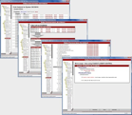
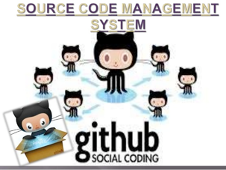

What problem are we trying to solve?
Many developers contributing and changing shared files for a common product
How to manage the changes and configurations?

Slide 100
Benefits of Configuration Management
Easy access to current and previous versions of files
Compare file versions: what changed?
Revert to earlier versions of a file
Facilitate collaboration across team
Support many developers working on the same files
Create branches to explore new features
Automatically merge multiple changes
Files can be backed up in multiple places

Slide 101
Git Concepts
Repository
Files are stored in a repository
Developers add features or fix bugs in a Local repository
Local copy of the repository
Files are merged and shared in Remote, shared repository
Shared server, e.g. github.com
Branch
A branch isolates changes in a specific context
Create new features, do bug fixes, experiment, …
e.g. Master branch may represent the current product
Dev branch may represent change for a group of features

Slide 102
Git Concepts
Commits
A unit of work, i.e. a collection of related changes, written to the repository
New feature, bug fix, …
May involve one or more files, but should represent a logical unit of functionality
Changes should committed frequently to a branch, but only when the feature is complete

Slide 103
Git Concepts
Fetch/Push/Pull/Merge
Developers typically make changes to the local repository
We need to sync the multiple local repositories back into a branch in the the common, remote repository
Fetch retrieves the latest structure from the remote repository, including all commits and latest changes
Push pushes the local changes up to the remote repository and merges the changes from all contributors
Pull pulls down changes from the remote repository and merges the changes into the local repository
Merge combines changes within or across branches

Slide 104
Simplified Work Flow
Remote Repository
* Push and Pull merge changes across files
Developer Environment
Clone Existing Repository
Create new
Branch
Pull* changes from remote repository
New features / bug fixes
Commit change to local repository
Push* changes to remote repository
Create new
Repository

Slide 105
Git/GitHub Review…
Walk through a common scenario…
Create a remote repository for a new project on github.com
Clone the remote repository to a local repository
Create a new ‘dev’ branch
Create a new file in the local repository
Commit changes locally
Push changes to the remote repository
Change the file in the remote repository
Pull the changes from the remote repository
Merge ‘dev’ and ‘master’ branch

Slide 106
What to store in GitHub?
All important project artifacts
Source files
Documents
Test cases
Test results
…

Slide 107
Database Overview
Databases contain a collection of related information, organized to allow efficient access and retrieval
Several different database solutions:
Relational Database Management System (RDBMS) – data is structured in predefined tables by row and column
Object Oriented Databases – all data is represented and stored by objects
NoSQL - unstructured data is stored and processed in potentially massively parallel solutions
Source: http://www.dictionary.com/browse/object

Slide 108
Why use a RDBMS?
Why not just store data in a flat file?
(Flat files may be the best solution for some problems)
Databases support:
Transaction processing/Atomicity
Multiple concurrent simultaneous users
A common query language across vendors
Data consistency enforcement
Access control

Slide 109
ACID properties
A transaction must have ACID properties
Atomic - all steps complete successfully or no change
Consistent – both successful and unsuccessful transactions must leave the system in a consistent state
Isolated – the data involved in the transaction must be isolated from other users until the transaction is complete
Durable – the changes must survive permanently

Slide 110
Relational DBMS Characteristics
Data represents real world entities
Data stored in relational tables
Tables are analogous to spreadsheets with rows and columns
Tables may be related by “keys” which can be used to join multiple tables to find related information
Tables are designed to minimize redundant information
Use query languages (SQL) to retrieve information
Support transactions for consistency
Support multiple concurrent users

Slide 111
Select Where
Select a set of rows and columns from one or more tables that meet the specified criteria
SELECT column₁, …, column_{n}
FROM table
WHERE column <operator> <value>
Operators include =, !=, <>, >, <, >=, <=, !<, !>
select name, Title from Employees
where name = ‘Jim’
select * from Employees
where salary >= 70000
Select returns a result table

Slide 112

Joins
Data is frequently stored in multiple tables
Use keys to join multiple related tables
Primary Key
One or more columns
Uniquely identifies a row in a table
Foreign Key
Refers to a Primary Key in a different table
Used to join tables
Not all tables have keys but we can join on any field

Slide 113
Database Operations and Python APIs
Commit
Connect to Database
Execute Queries
Close Database
Rollback

Slide 114

SQL Injection Attacks
Scenario:
A bad actor is authorized to see only his own salary but wants to know all salaries
A naïve developer concatenates user input as part of the query
The bad actor injects extra SQL in the input to change the query
Matches ALL rows

Slide 115

Preventing SQL Injection Attack on Parameterized Query
Include ‘?’ in the query for each parameter and pass the parameters separately as a tuple
execute checks the parameters to prevent SQL Injection attacks
Specify ‘?’ in the query for each parameter
Pass the arguments to execute() as a tuple

Slide 116

Dynamic Web Pages
1. GET All Students
5. Render HTML
4. Return generated HTML
<!DOCTYPE html>
<html>
<TABLE>
<LI>Brown, C</LI>
<LI>Hou, F</LI>
</body>
</html>
2. Get student data
3. Create HTML dynamically
http://testpad.asna.com/tutorials/Images/DataServerWebServer.gif

Slide 117
Python, Flask, Jinja2
Flask serves the role of the Web Server
https://gertjanvanhethofblog.wordpress.com/2016/02/10/exploring-flask-on-raspberry-pi/

Slide 118



Displaying tables with Flask & Jinja2
Templates/student_table.html
Browser Window
Stevens.py

Slide 119
CRUD
All persistent storage solutions must support CRUD operations

Slide 120
RDBMS Alternatives
Big Data applications created a need for new solutions
Many applications involve large data sets (Exabytes)
E.g. imagine Google searching 30 trillion web pages 100 billion times a month from a MySQL database
Source: http://venturebeat.com/2013/03/01/how-google-searches-30-trillion-web-pages-100-billion-times-a-month/

Slide 121
NoSQL
Unstructured data vs structured relational data
NoSQL supports structured, semi-structured and unstructured data
Replace relational tables with flexible structures
Spread the data across clusters of computers
NoSQL solutions are schema-less
Priorities:
High performance
High availability
Scalability
http://www.smartdatacollective.com/sites/smartdatacollective.com/files/RDBMSvsNoSQL.jpeg

Slide 122
CAP Theorem (Brewer’s Theorem)
Distributed solutions require tradeoffs decided by business needs
Can’t have all three simultaneously
Consistency: Data is consistent across clients after an operation
NA
Partition Tolerance: system is able to function, even when communication between servers is unreliable
Availability: High system availability

Slide 123
Document oriented NoSQL databases
Store the entire document of key/value pairs
Typically JSON documents
”File” the document in the database
Use key to access the document
Store many types of document in a single collection
Store any kind or amount of data
No predefined schema
Very flexible to facilitate changes

Slide 124

Questions?

